Slide 1
Group P
Pneumonia Detection
from Chest X-Rays using CNN
Team Details: Konark shah: 40232277
Vandit Mehta: 40232414
Urvilkumar Patel: 40230360
Anurag Teckchandani: 40263724

Slide 2
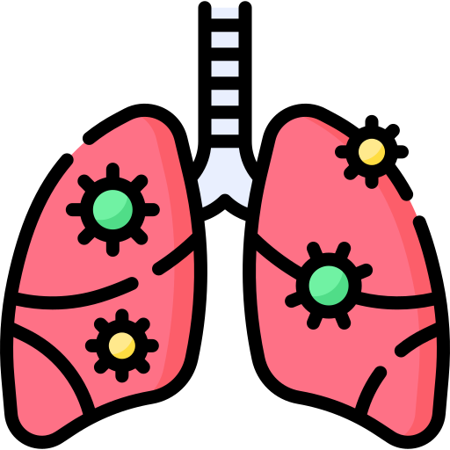
Pneumonia Detection as a Problem and its Importance
Serious Respiratory Infection
Leading cause of morbidity
and mortality worldwide.
Complex Diagnosis
Diagnosis can be difficult due to shared symptoms.
Shortage of Professionals
Dependent on expert interpretation and medical access.
Potential AI solutions
AI adoption challenges: dataset diversity, model interpretability,
and generalizability.

Slide 3
Goals of the Project
01
03
Create an AI system for pneumonia detection using CNNs on chest X-rays.
Assess CNN performance (ResNet18, DenseNet121, InceptionV3) across diverse datasets using multiple metrics.
02
04
Address the challenge of accurate pneumonia diagnosis, especially in resource-constrained healthcare settings.
Enhance healthcare and patient outcomes with improved pneumonia detection through AI.

Slide 4
Methodology: Used Datasets
 | Details of Each Datasets of the Project
01 | Dataset 1 | Categories: Pneumonia and Normal Resolution: 1120 x 800 pixels Training: 3,514 images Validation: 878 images Testing: 1,464 images
02 | Dataset 2 | Categories: Bacterial, Covid-19, Lung Opacity, Normal, Viral Resolution: 1780 x 1800 pixels Training: 2,020 images Validation: 500 images Testing: 1,035 images
03 | Dataset 3 | Categories: 14 lung disease classes including pneumonia Resolution: 1024 x 1024 pixels Training: 67,272 images Validation: 16,818 images Testing: 28,030 images

Slide 5
Methodology: CNN Models
x
x
ResNet18
Inception-V3
DenseNet121
Addresses vanishing gradient issue
18 layers Architecture
Parameters: ~11.7M
Input image size: 224x224 pixels
FLOPS: Approximately 1.8 billion
Vs
Utilizes filters with multiple sizes for wider networks
Approximately 23.8 million parameters
Input image size: 299x299 pixels
FLOPS: Approximately 5.7 billion
Vs
Chosen for dense connectivity promoting reuse
121 layers Architecture
Parameters: ~7.0M
Input image size: 224x224 pixels
FLOPS: Approximately 2.9 billion

Slide 6
Methodology: Optimization Algorithm
01
SGD updates parameters by subtracting a fraction of loss gradient.
02
Utilized Stochastic Gradient Descent (SGD) optimization algorithm
Momentum value of 0.9 set for accelerated convergence
Learning rate of 0.001 varied to optimize model convergence
04
03
Loss function: Cross entropy loss
Evaluation metrics: Accuracy, Precision, Recall, F1-score
06
05
07
Utilized t-SNE for visual comparison of feature distributions in lower-dimensional space
Model hyperparameters:
Optimizer: SGD
Learning rate: 0.001
Batch size: 30
Loss function: Cross entropy loss
Number of epochs: 30
08

Slide 7
Experimental Setup
Utilized SGD, ReLU, and optimized hyperparameters; evaluated using accuracy, loss, and confusion matrices on validation/test data.
04
Data augmentation techniques, including normalization, were applied during training.
03
Dataset split into 60:15:25 ratios for training, validation, and testing.
02
Data from three Kaggle sources was preprocessed: cleaned, resized, and converted to PIL Image format and torch.float32.
01

Slide 8
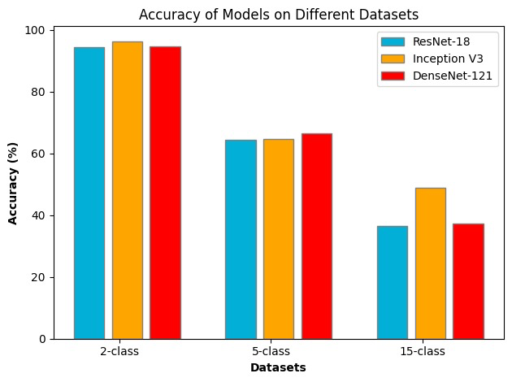
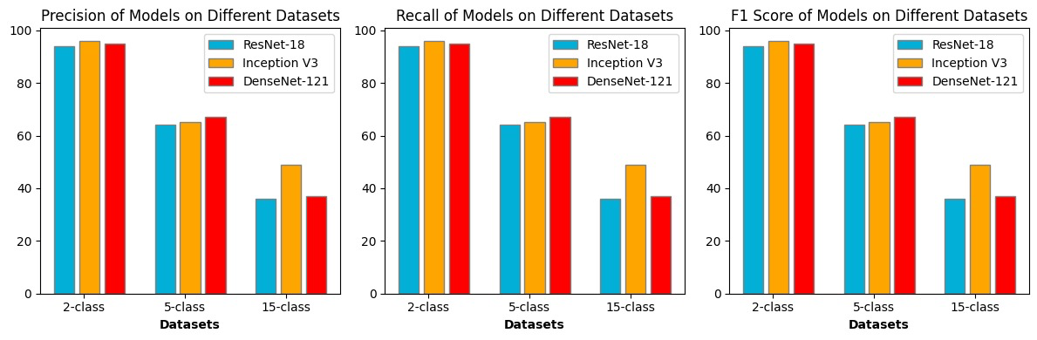
Main Results
02
03
04
05
01
Inception v3 demonstrates the highest accuracy across datasets, while ResNet-18 tends to overfit.
Performance declines as the number of classes in the dataset increases.
Inception v3 demonstrates the highest accuracy across datasets, while ResNet-18 tends to overfit.
Inception v3
consistently outperforms ResNet-18
and DenseNet-121
across all datasets
Accuracies of 96.39%, 64.63%, and 49.02% for Inception v3, and 94.35%, 64.44%, and 36.43% for ResNet-18 and DenseNet-121.

Slide 9
Hyper Parameter Tuning and Ablative Study
01 | Hyperparameter Tuning
 | Learning rate adjustment crucial for model convergence. Optimal learning rate for ResNet-18 on a 5-class dataset was 0.001, with limited computational resources preventing further hyperparameter fine-tuning.
02 | Transfer Learning
 | Pretrained weights from IMAGENET1K V1 used for ResNet-18 and DenseNet-121. Pretrained models improve initial accuracy and convergence speed, while overfitting is countered with regularization and data augmentation.
03 | Feature Understanding using t-SNE
 | t-SNE visualization reveals class clusters and overlap. Pretrained weights lead to more generalized but less distinct feature representations.
04 | Ablative Study
 | Learning Rate Finder tool identifies optimal learning rate of 0.001. Performance metrics inversely correlate with the number of classes in the dataset.

Slide 10
References
Varshni, D., Thakral, K., Agarwal, L., Nijhawan, R., Mittal, A. (2019). Pneumonia Detection Using CNN-based Feature Extraction. IEEE International Conference on Electrical, Computer and Communication Technologies (ICECCT), 2019. Coimbatore, India. pp. 1-7. doi: 10.1109/ICECCT.2019.8869364.
Xie, S., Girshick, R., Doll´ar, P., Tu, Z., He, K. (2017). Aggregated residual transformations for deep neural networks. In Proceedings of the IEEE Conference on Computer Vision and Pattern Recognition, Honolulu, HI, USA, 21–26 July 2017; pp. 1492–1500. IEEE.
Huang, G., Liu, Z., Van Der Maaten, L., Weinberger, K.Q. (2017). Densely connected convolutional networks. In Proceedings of the IEEE Conference on Computer Vision and Pattern Recognition, Honolulu, HI, USA, 21–26 July 2017; pp. 4700–4708. IEEE.
Szegedy, C., Vanhoucke, V., Ioffe, S., Shlens, J., Wojna, Z. (2016). Rethinking the inception architecture for computer vision. In Proceedings of the IEEE Conference on Computer Vision and Pattern Recognition, Las Vegas, NV, USA, 27–30 June 2016; pp. 2818–2826. IEEE.
Vantaggiato, E.; Paladini, E.; Bougourzi, F.; Distante, C.; Hadid, A.; Taleb-Ahmed, A. COVID-19 Recognition Using Ensemble-CNNs in Two New Chest X-ray Databases. Sensors 2021, 21, 1742. https://doi.org/10.3390/s21051742
Elgeldawi, E.; Sayed, A.; Galal, A.R.; Zaki, A.M. Hyperparameter Tuning for Machine Learning Algorithms Used for Arabic Sentiment Analysis. Informatics 2021, 8, 79. https://doi.org/10.3390/informatics8040079
Suhirman, Suhirman & Rianto, Rianto & Santosa, Paulus & Yunanto, Rio. (2023). THE ENSEMBLE METHOD AND SCHEDULED LEARNING RATE TO IMPROVE ACCURACY IN CNN USING SGD OPTIMIZER. Journal of Engineering Science and Technology. 18. 2779-2792.
Tyagi, Arnav & Khandelwal, Rishabh & Shelke, Nitin & Singh, Jagendra & Rajpal, Dev & Gaware, Ishaan. (2024). Comparitive Analysis of Various Transfer Learning Apporaches in Deep CNNs for Image Classification. 10.1007/978-3-031-53082-127.
Prathivi, Rastri. (2020). The Optimization of Transfer Learning Convolutional Neural Network Model with PCA and t-SNE Algorithms for Classification and Recognition of CIFAR-10 Image. Jurnal RESTI (Rekayasa Sistem dan Teknologi Informasi). 4. 717-722. 10.29207/resti.v4i4.2131.

Slide 11
THANK YOU

